Slide 1

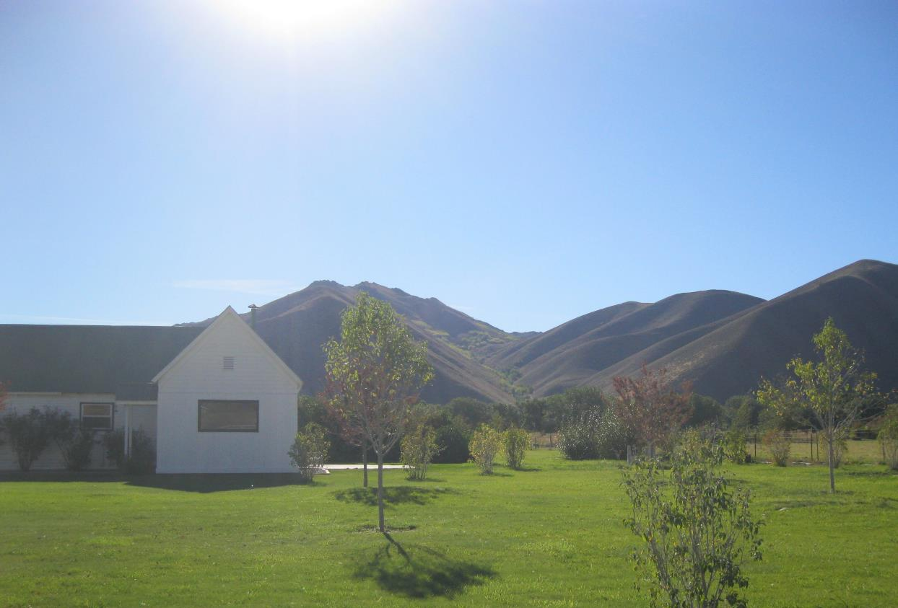
Friedman Memorial Airport
Environmental Assessment
Proposed Property Acquisition for Approach Protection and Land Use Compatibility
Project Update
December 7, 2021

Slide 2
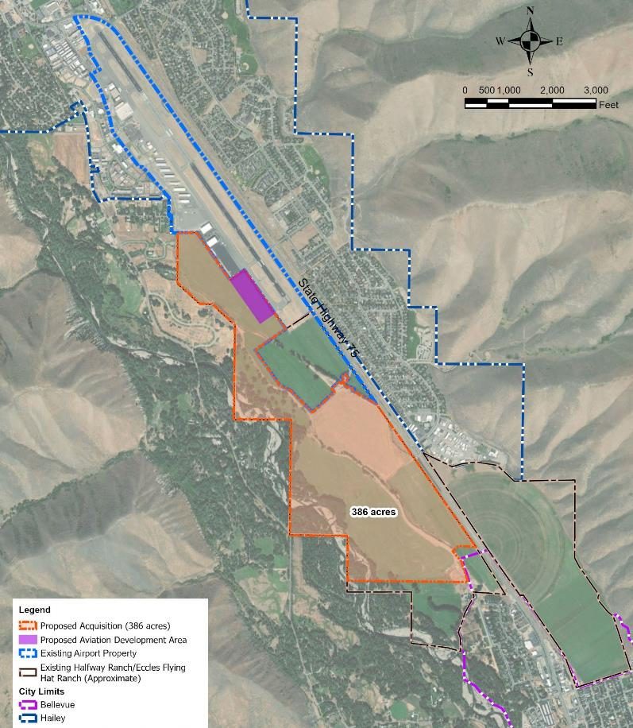
Proposed Action & Project Need
Acquisition of 386 Acres
  Approach Protection
  Land Use Compatibility
Development of 10 Acres for General Aviation
  Replacing aviation facilities (apron and hangars) lost as a result of the Runway Safety Area (RSA) project
  Provide additional aircraft hangars
Notes:
Note what’s not included

Slide 3
National Environmental Policy Act (NEPA)
Projects Require Federal Action by FAA
FAA Must Comply with NEPA
Three Levels of Review
  Categorical Exclusion (CatEx)
  Environmental Assessment (EA)
  Environmental Impact Statement (EIS)

Slide 4
Environmental Assessment Process
Identification of Proposed Project
Environmental Analysis and Agency Coordination
Publish Environmental Assessment (EA)
Public Review and Comment
Final EA/FAA Finding of No Significant Impact (FONSI)

Slide 5
Assessment Categories
Air Quality
Biological Resources
Climate
Coastal Resources
Department of Transportation Act, Section 4(f)
Farmlands
Hazardous Materials, Solid Waste, and Pollution Prevention
Historical, Architectural, Archeological, and Cultural Resources
Land Use
Natural Resources and Energy Supply
Noise and Noise-Compatible Land Use
Socioeconomics, Environmental Justice, and Children's Environmental Health and Safety Risks
Visual Effects
Water Resources
Cumulative Impacts
Irreversible and Irretrievable Commitment of Resources

Slide 6
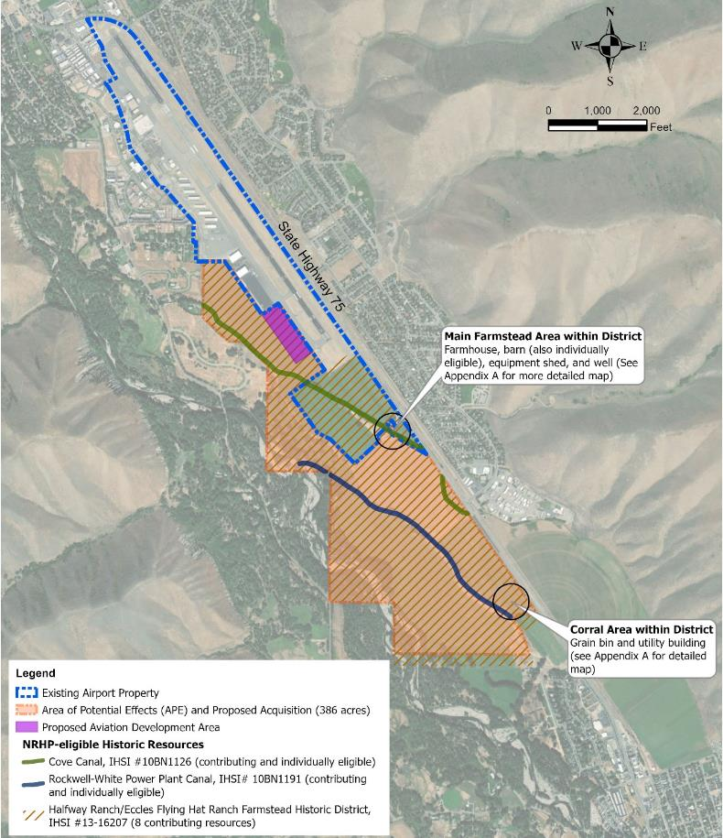
Historical, Architectural, Archeological, and Cultural Resources
Potential to effect Halfway Ranch/ Eccles Flying Heart Ranch Historic District
Section 106 of the Historic Preservation Act
  Requires federal agencies to consider the effects of their undertaking (or action) on properties listed in or eligible for listing in the National Register of Historic Places
  Requires consultation with the Idaho State Historic Preservation Officer (SHPO)

Slide 7
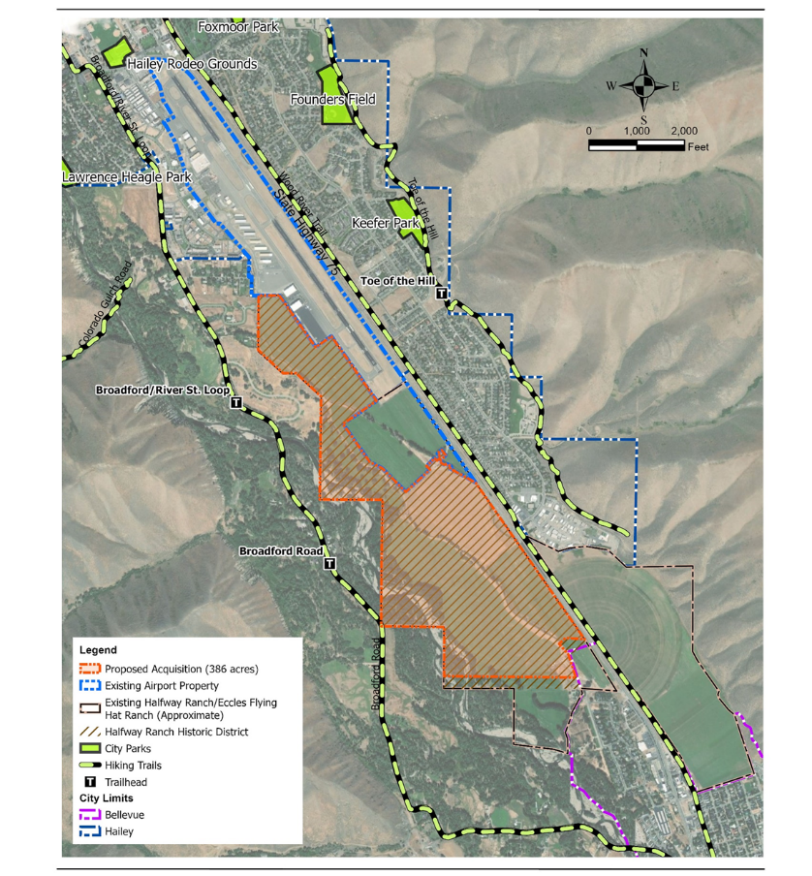
DOT Section 4(f)
  Consideration of park and recreation lands, wildlife and waterfowl refuges, and historic sites
  Must determine that there is no feasible and prudent alternative that avoids the Section 4(f) properties
  All possible planning to minimize harm to the Section 4(f) properties

Slide 8
DOT Section 4(f)
  De minimis Impacts for Historic Sites
  FAA determines that either no historic site is affected by the project or that the project will have "no adverse effect" on the historic site

Slide 9
FAA Section 106 Determination
  FAA determined No Historic Properties Adversely Affected
State Historic Preservation Office (SHPO) has Concurred with FAA determination

Slide 10
FMAA Responsibilities
FMAA to include a special lease provision in future agricultural lease agreements to provide for the maintenance of contributing elements of the property in the Historic District
Future modifications to property could require Section 106 and DOT Section 4(f) determinations

Slide 11
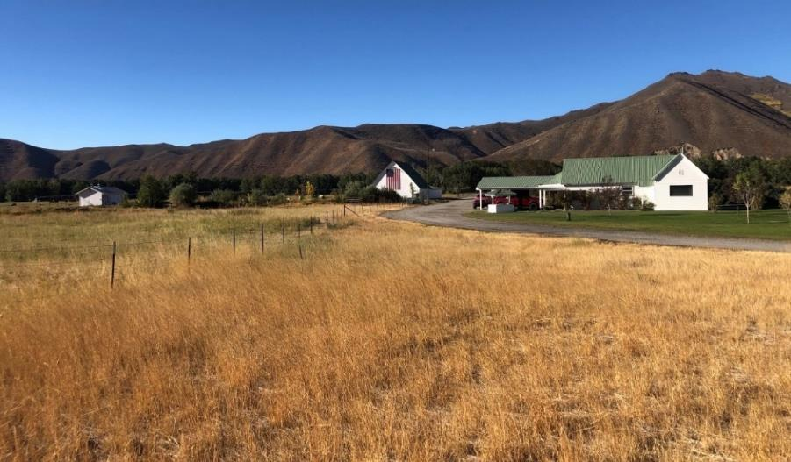
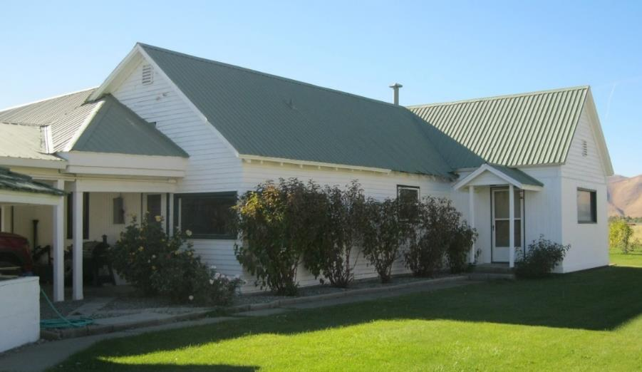
Historical, Architectural, Archeological, and Cultural Resources
Photo 1. Overview of the core of the determined-eligible Halfway Ranch/Eccles Flying Hat Ranch Historic District as seen from State Highway 75.
Photo 2. Detail of east elevation on the contributing farmhouse, view facing northwest.

Slide 12
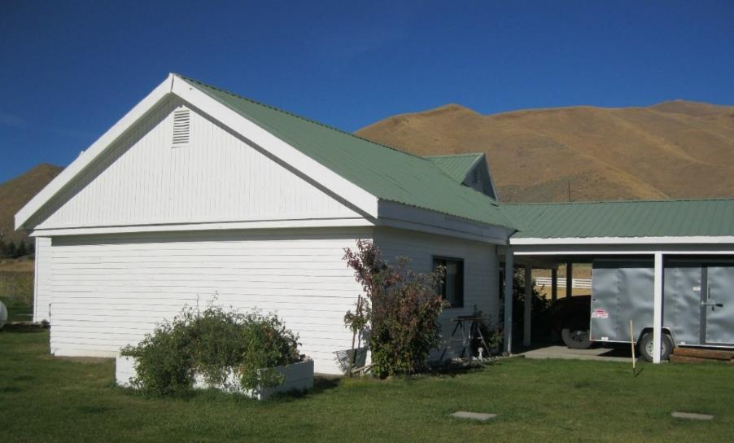
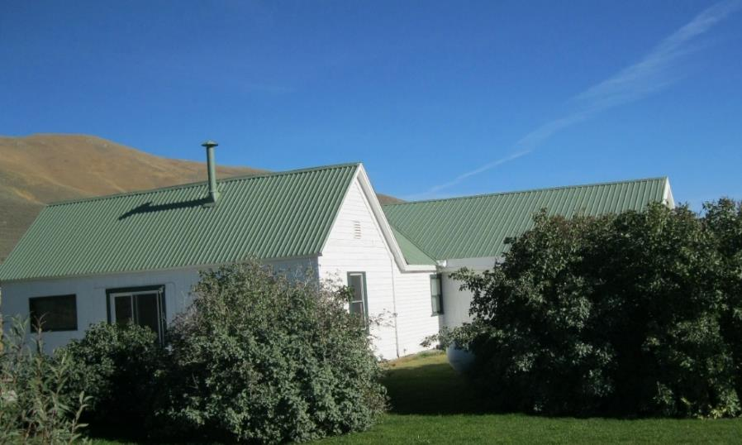
Historical, Architectural, Archeological, and Cultural Resources
Photo 3. Detail of south and east elevation on the contributing farmhouse, view facing northeast.
Photo 4. Detail of north and west elevations on the contributing farmhouse, view facing southeast.

Slide 13
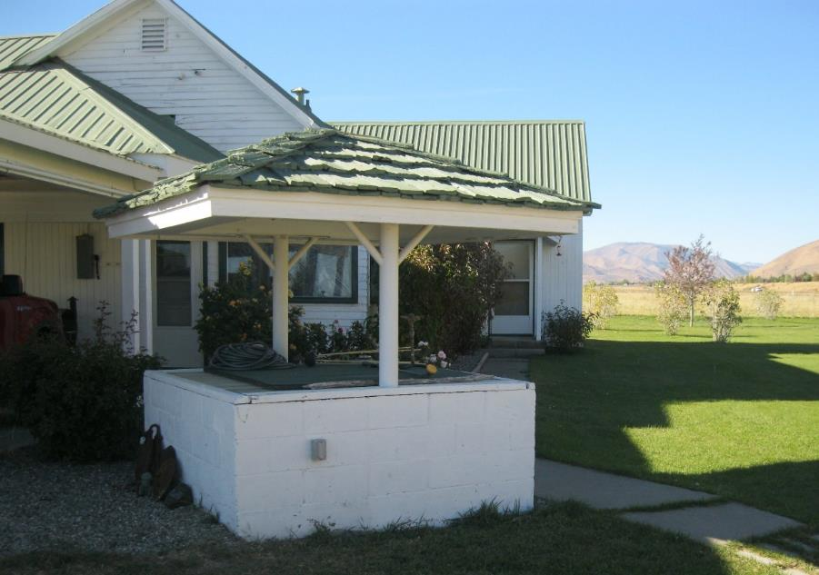
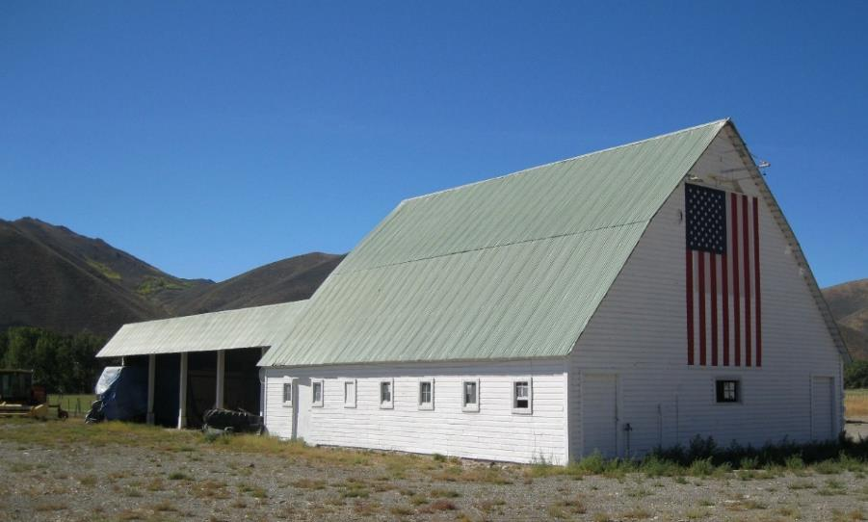
Historical, Architectural, Archeological, and Cultural Resources
Photo 5. View of the contributing well, view facing northwest.
Photo 6. Individually eligible barn and contributing barn, view facing west.

Slide 14
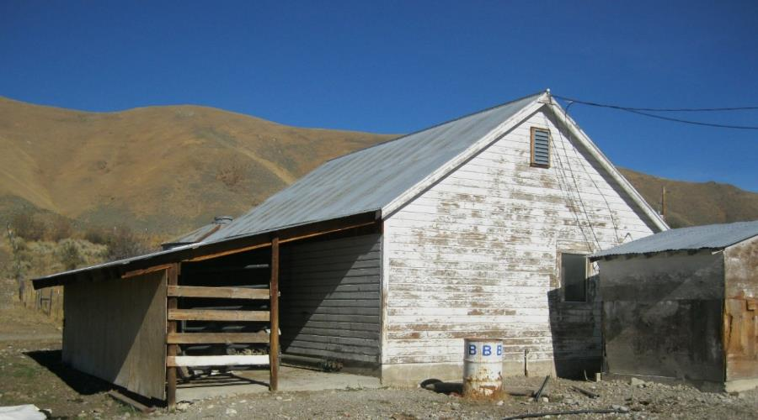
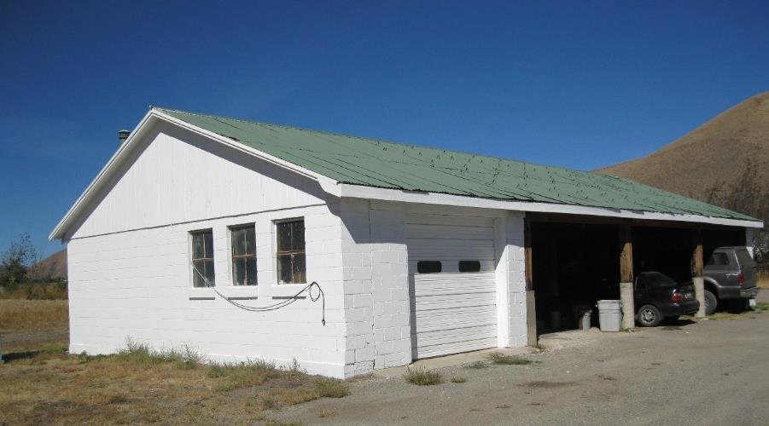
Historical, Architectural, Archeological, and Cultural Resources
Photo 7. Contributing equipment shed, view facing northeast.
Photo 8. Contributing utility building and grain bin (roof visible in background), view facing northeast.

Slide 15
Historical, Architectural, Archeological, and Cultural Resources

Slide 16
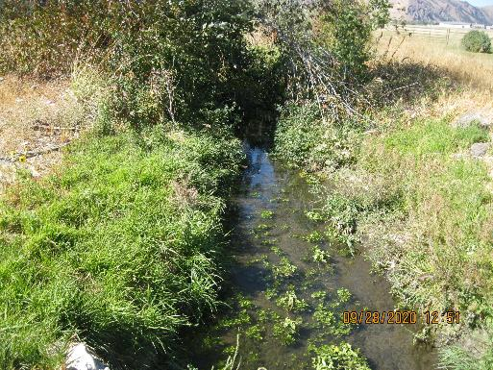
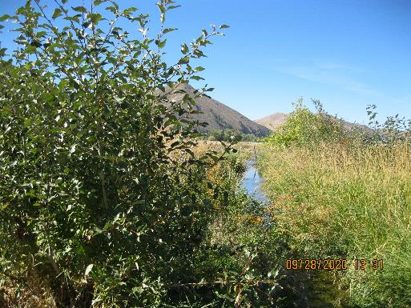
Other Resources
Biological Site Review
Wetlands Survey
Hazardous Materials Assessment

Slide 17
Stakeholder Outreach
Public and agency comment period expected early this spring
Document posted on website and published in local locations
Additional updates on outreach during February FMAA meeting

Slide 18
Schedule
Preliminary Draft EA Chapters Sent to FAA
Public review of Draft EA after FMAA Board and FAA approval
FAA decision expected spring 2022

Slide 19
Questions
Clarifications
Answers
Discussion
Thank You.

